Slide 1

Real-Time AI Sales Intelligence and Sentiment-Driven Deal Negotiation
- Smarter Sales, Better Deals

Slide 2
CONTENT:
Introduction
Problem Statement
Objectives
Features
Architecture Diagram
Technology Stack
Future Enhancements

Slide 3
Introduction
The Real-Time AI Sales Intelligence and Sentiment-Driven Deal Negotiation Assistant is an AI-powered tool that enhances sales calls with real-time sentiment analysis and dynamic deal recommendations.
Analyzes buyer sentiment to adjust negotiation strategies instantly.
Suggests personalized deal terms based on CRM data and buyer needs.
Provides detailed summaries and insights for future engagement.
Offers real-time recommendation for handling objections and improving negotiation .

Slide 4



Problem Statement
Sales teams struggle to understand buyer sentiment and adapt negotiation strategies in real-time.
Lack of personalized deal recommendations based on historical CRM data and buyer needs.
Difficulty in providing actionable insights and performance feedback post-call.
Limited tools for improving sales efficiency and conversion rates during negotiations.

Slide 5
Objectives
Implement real-time sentiment analysis to monitor and adapt negotiation strategies during sales calls.
Develop a dynamic deal recommendation system based on buyer needs, historical data, and competitor benchmarks.
Provide post-call insights and performance summaries to enhance future engagement strategies.
Improve sales team efficiency by offering actionable recommendations and negotiation coaching in real-time.

Slide 6
Features
Real-time sentiment analysis : Monitors and adapts negotiation strategies based on buyer sentiment during calls.
Dynamic deal recommendations : Provides personalized deal terms based on buyer data and market insights.
AI-driven objection handling : Offers real-time suggestions for addressing objections and improving negotiation.
Post-call insights : Delivers actionable summaries and performance feedback to optimize future engagements.
AI-powered negotiation coach : Provides real-time coaching, offering tips and strategies to enhance negotiation skills.

Slide 7
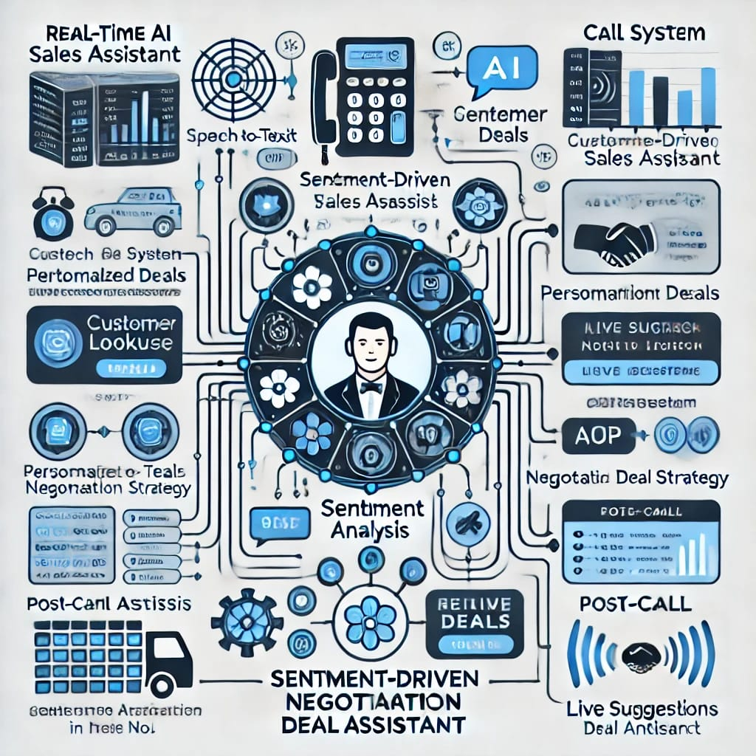
Architecture Diagram

Slide 8
Technology Stack
Frontend:
1.User Interface: React, Angular, or Vue.js
2.Visualization: D3.js, Chart.js, or Highcharts
Backend:
1.Server: Node.js, Python (Flask/Django), or Java (Spring Boot)
2.Database: MongoDB, PostgreSQL, or MySQL
3.API Gateway: NGINX, AWS API Gateway, or Google Cloud EndpointsAI and NLP:
1.Natural Language Processing (NLP): NLTK, spaCy, or Stanford CoreNLP
2.Machine Learning: scikit-learn, TensorFlow, or PyTorch
3.Deep Learning: Keras, TensorFlow, or PyTorch
4.Sentiment Analysis: VaderSentiment, TextBlob, or IBM Watson Natural Language
Understanding Integration and Automation
1. CRM Integration: Salesforce, HubSpot, or Zoho

Slide 9
Future Enhancements
Enhanced multilingual support: Expanding language capabilities to cater to global sales teams and diverse buyer bases.
Real-time competitor analysis: Integrating tools to monitor competitor actions and adjust negotiation strategies accordingly.
Autonomous Negotiation Assistant: Enabling the AI to handle certain negotiation tasks independently, such as presenting deal terms, responding to objections, and closing deals, with minimal human intervention.

Slide 10
THANK YOU!

